Slide 1
Moving apart limits
of opportunities

Slide 2
About OUR STUDIO
Hello! We are East European company from Azerbaijan.
OUR STUDIO — is young and perspective team of experts which want to solve problems our clients and make business better today already!
Design
Development
Quality assurance
Attractive web design plays a key role in successful online sales and marketing
OUR Studio can help your
business drive operational
improvements with custom development tailored to your specific business requirements
Competition winning quality gives your platform stable ground

Slide 3
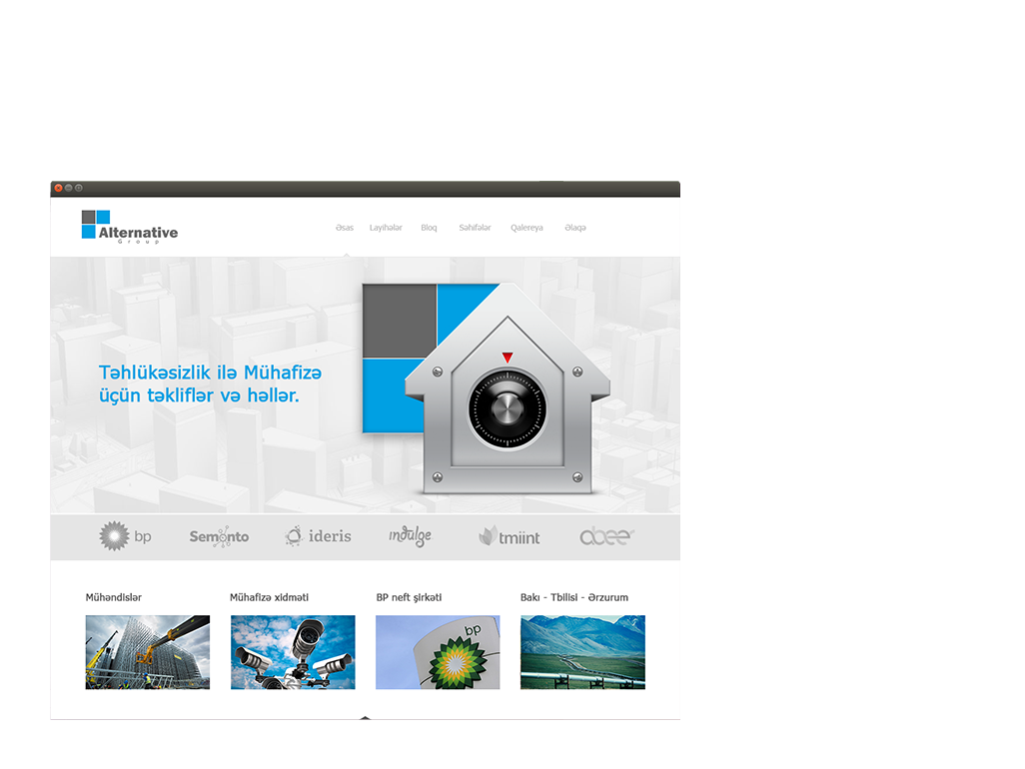
Alternative Group
Technology: OUR Engine, PHP, MySQL, JQuery, JavaScript, HTML5, CSS3.
Description: Alternative Group which offers security and protection, as well as offers a variety of solutions for protection the strategic object and areas of Azerbaijan, is one of the largest companies. Specific site was created for it.
Site: www.alternativegroup.az

Slide 4
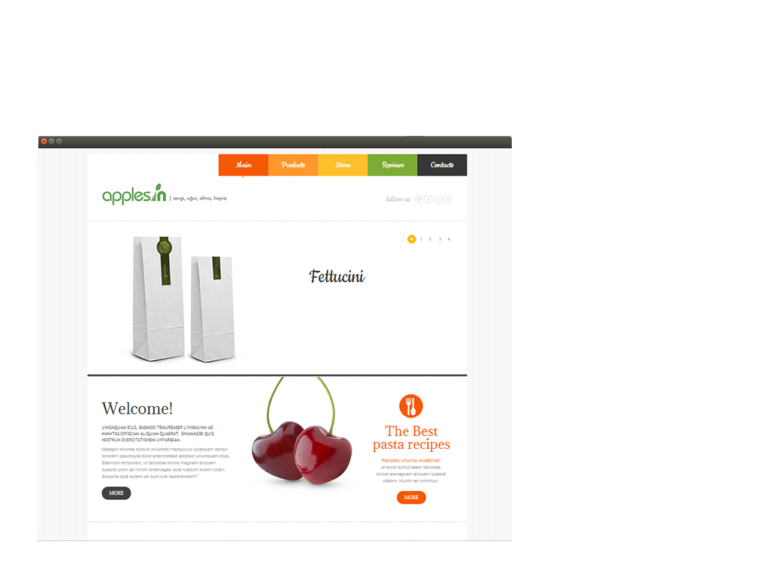
ApplesIn
Technology: OUR Engine, PHP, MySQL, JQuery, JavaScript, HTML5, CSS3, LS.
Description: Organic nutrition Company, which makes various salads and drinks from fruits. When we thinking about the brand choice for Applesin, the preference was given to its unique style of the natural elements. Simple, elegant and organic.
Site: www.applesin.az/

Slide 5
Center for Strategic Studies
Technology: OUR Engine. PHP, MySQL, JQuery, JavaScript, HTML5, CSS3, LocalStorage.
Description: Center for Strategic Studies under the President of the Republic of Azerbaijan is Azerbaijan’s first governmental, non-profit think tank founded on November 12, 2007 by the Decree of the President of the Republic of Azerbaijan, Mr. Ilham Aliyev. Its headquarters is located in Baku, Azerbaijan. The site was founded on a powerful platform based on the state standards.
Site: www.sam.gov.az

Slide 6
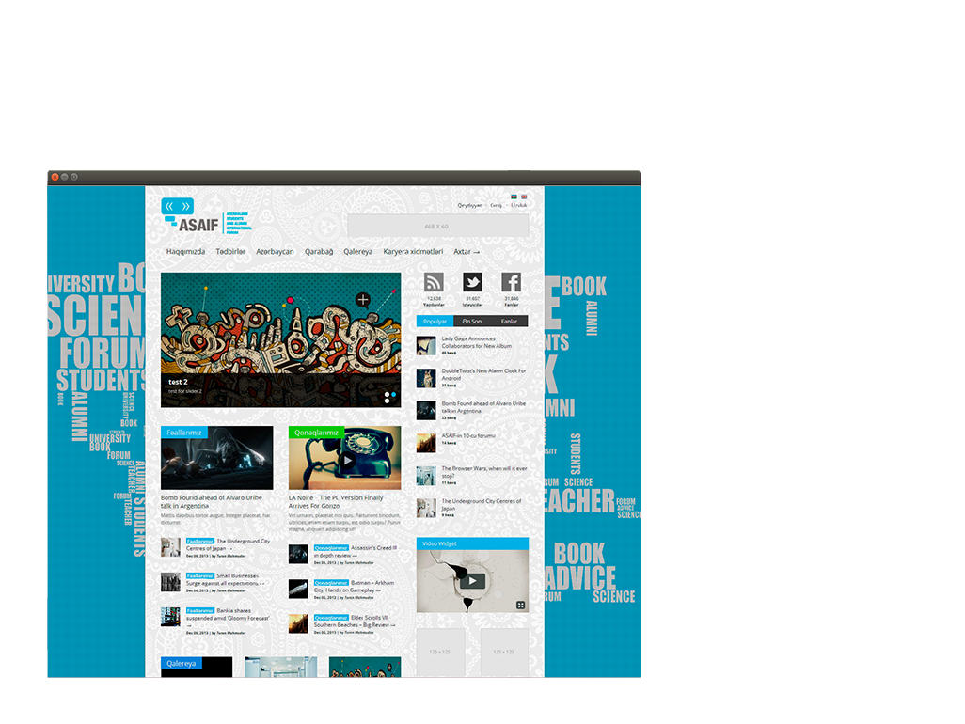
ASAIF
Technology: OUR Engine, PHP, MySQL, JQuery, JavaScript, HTML, CSS, Bootstrap
Description: The website that created for Azerbaijani students and Alumni International Students combines in itself the emotions of passion and youth. This website has the advantages like supporting new social adds that are in use by young people, having a wide category of choices and being in a great design.
Site: www.asaif.az

Slide 7
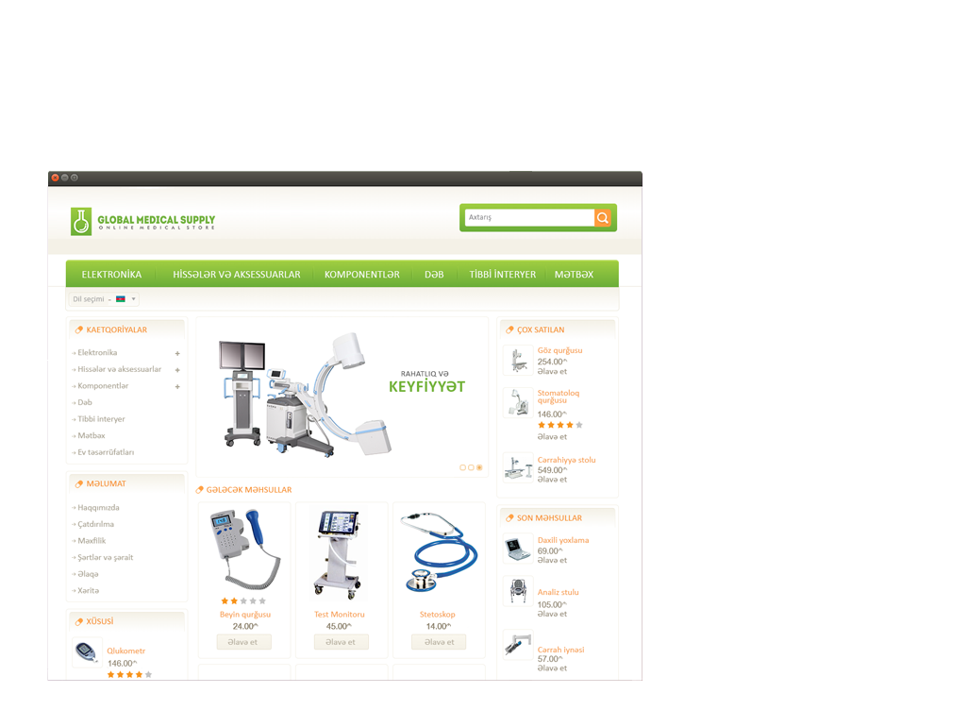
Global Medical Supply
Technology: OUR Engine, PHP, MySQL, JQuery, JavaScript, HTML5, CSS3, LocalStorage.
Description: The official website of Global Medical Supply – The company which provides sales medicine and equipment of "Sağlam Ailə" Clinic. The website has developed as e-shop style to demonstrate the products. Set of colors adapted to logo of company and created optimal design.
Site: www.medsupply.az

Slide 8
Caucasus International
Technology: OUR Engine, PHP5, MySQL, Jquery, JavaScript, HTML5, CSS3
Description: Caucasus International (CI) is a foreign policy journal based in Istanbul. CI is the first journal, in both substance and quality, to provide a platform for debate among scholars from all the countries of the South Caucasus and Turkey. Caucasus International is published by the Ankara-based Eurasian Association of Scientists in collaboration with the Center for Strategic Studies (SAM) in Baku.
Site: www,cirjounal.org

Slide 9
Intellekt
Technology: OUR Engine, PHP5, MySQL, Jquery, JavaScript, HTML5, CSS3
Description: "İntellekt" company has been operating since 1995. The Company engaged in the sale of office accessories and equipment, as a independent company. We have stayed faithful eCommerce ideas for Intelligence site. The website of Company are colorful and multifaceted.

Slide 10
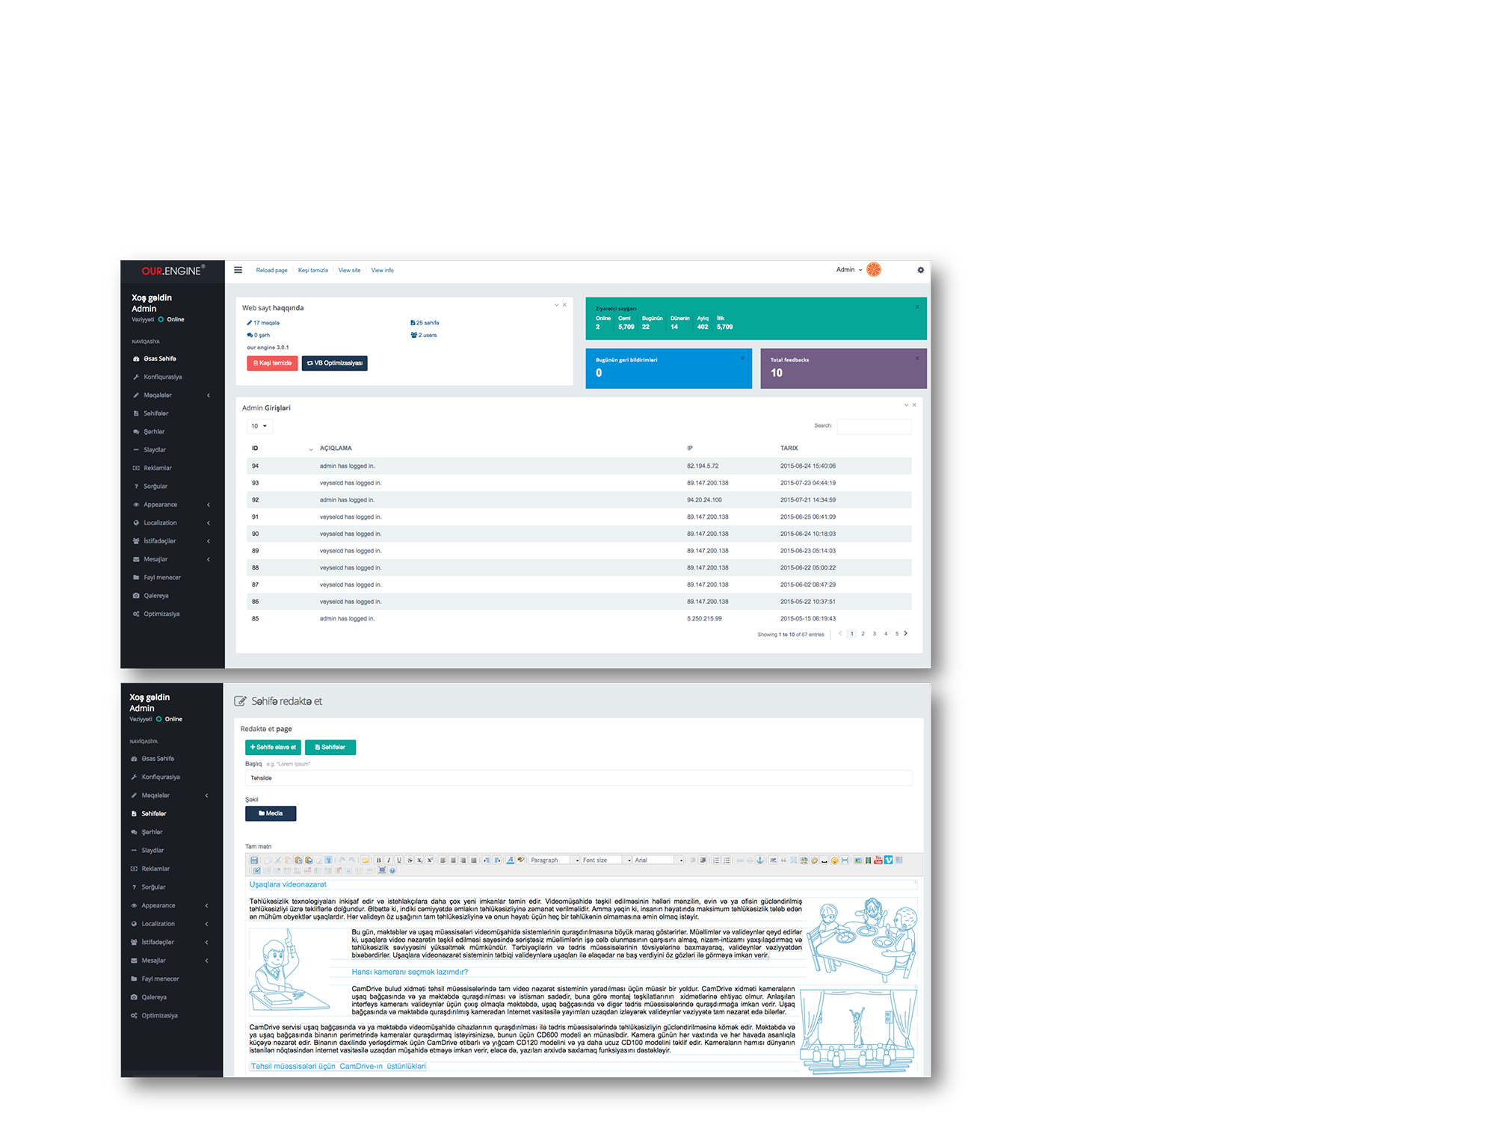
OUR Engine®
Description: OUR Engine® is a our computer application that allows publishing, editing and modifying content, organizing, deleting as well as maintenance from a central interface. Such systems of content management provide procedures to manage workflow in a collaborative environment.
OUR Engine® content management system is one of the our best and powerfull project in IT industry.
Site: www.our.az

Slide 11
FishPort
Technology: Adobe Photoshop, CorelDraw, GIMP
Description: Fish Port Azerbaijan is the new fast food company which is created in Azerbaijan, Russia and in Turkey. As its nutrition service is realised by fish and fish products and as being the fast food company, they've created new brand and conceptual design over it by keeping the adopted traditions.
Site: www.baliq.az

Slide 12
Güvən Insurance
Technology: Adobe Photoshop, CorelDraw, GIMP
Description: GUVEN Assurance Agency is the new and one of the perspective companies. Its goal is to increase the quality of assurance which is very important for the citizens, by taking the European practice of Assurance system. G A agency's logo(symbol) is the combination of four G letter, which means Guven is always supporting all of its clients. And of course, 4G has been the symbol of fast internet as the technology has widen in our modern country. For the sake of fast and high-grade assurance.

Slide 13
Global Medical Supply
Technology: Adobe Photoshop, CorelDraw, GIMP
Description: Logo for Global Medical Supply. The Company engaged in the provision of medical equipment and laboratory preparations. We have used microscope elements for the logo. We believe that as well as one of the symbols of innovation - microscope is unique choice for this logo.

Slide 14
Sirr — şirniyyat evi
Technology: Adobe Photoshop, CorelDraw, GIMP
Description: "Sirr Candy Store" is the one of the most popular candy store in the Baku. We have made a conceptual brand-book for them. We have also made a packaging and logos which compatible for profile. Each logo has own profile.

Slide 15
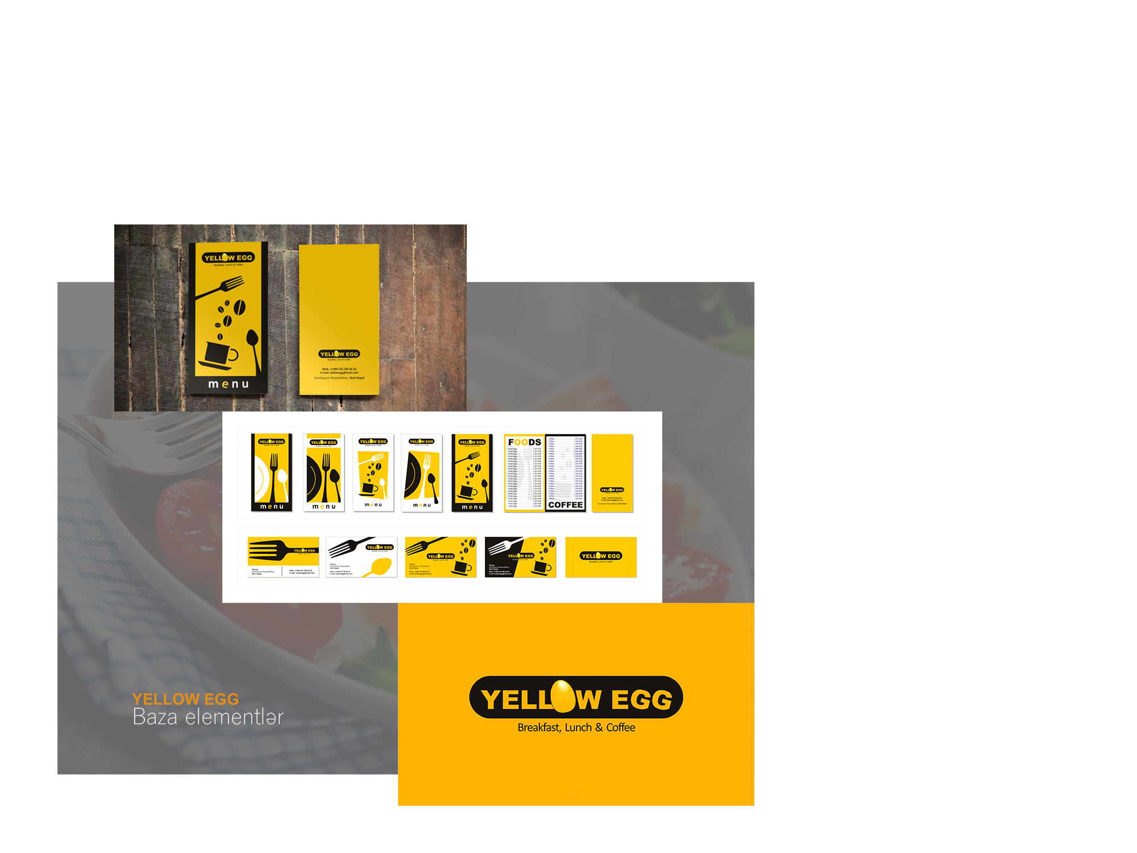
Yellow Egg
Technology: Adobe Photoshop, CorelDraw, GIMP
Description: Yellow Egg is the cafe-restaurant, where located in the "Yeni Həyat" (Azure) center of shopping and entertainment. This place is servicing morning foods. So we have made a logo and concept for these principles..

Slide 16
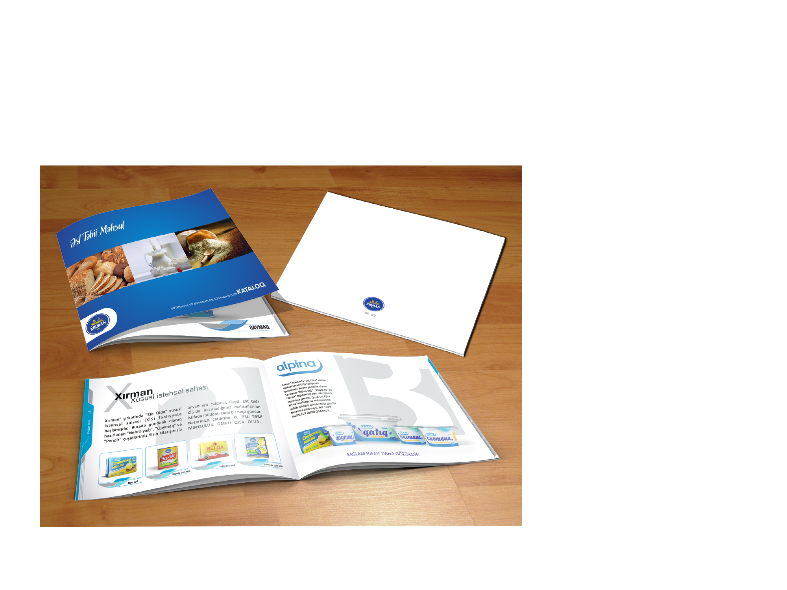
Xırman şirkəti
Technology: Adobe Photoshop, CorelDraw, GIMP
Description: "Xırman" has an important position in the food industry, where located in Azerbaijan Republic. The Company engaged in the specific production. We have made an extensive brand-book for the company, which based on natural elements.

Slide 17
ApplesInn
Technology: Adobe Photoshop, CorelDraw, GIMP
Description: Organic nutrition Company, which makes various salads and drinks from fruits. When we thinking about the brand choice for Applesin, the preference was given to its unique style of the natural elements. Simple, elegant and organic.

Slide 18
European Movement
Technology: Adobe Photoshop, CorelDraw, GIMP
Description: The brand-books of the Azerbaijan European Movement has been prepared by our company and that is the movement which aims to integrate to the institutions of society in Europe. This conceptual logo consists of one of the national symbols of Azerbaijan - its flag and also the flag of European Union. This logo is created to give the idea of integration, the exchange of experience and the corporation.
The logo is in use on documents and on the other leaflets of the movement.

Slide 19
How to start
work with us
1.
Get in touch with your personal manager(you can find contacts on the next page);
2.
Discuss your project with us and get free consultation and accurate estimate within 1–2 business days from our technical specialists;
3.
Elaborate all details and start your business with us.

Slide 20
Our contacts
ADRESS
TELEPHONE
239 A.Rajabli
+994 (012) 480-49-86
E-MAIL
COMPANY SITE
mail@ourstudio.az
ourstudio.az

